Slide 1
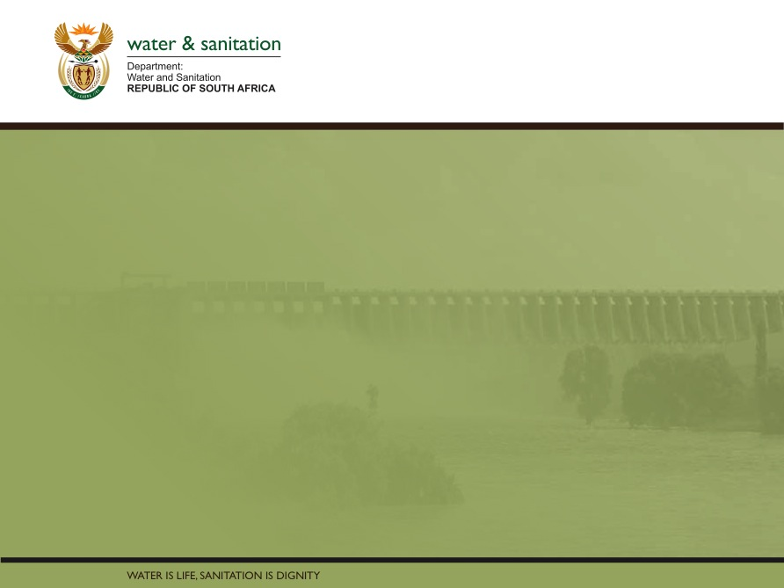
Classification, Reserve & RQO determination of water resources in the Mvoti to Umzimkulu Water Management Area
ECOSYSTEM SERVICES CONSEQUENCES
Greg Huggins
Nomad
16 Sept 2015
PRESENTATION TITLE
Presented by:
Name Surname
Directorate
Date

Slide 2
Ecosystem Services Approach
Series of key questions reflecting supply of provisioning, supporting, regulating and cultural services posed to specialist's.
E.g. Recreational Fishing – Will the scenario have an impact on recreational fishing? If yes what is the estimated magnitude of change?
Specialists scored each question for each scenario based on the expected impact against a base score of 1
Scores were then summed against services.
Services were weighted based on utilisation of estuary and a weighted score per scenario was generated.

Slide 3
Offshore impacts
An analysis of potential scenarios linked to offshore ecosystem services impacts was also undertaken.
For the most part this was linked to recreation as the key driver with potential water quality impacts associated with scenarios used the primary indicator for prediction.
Offshore impact was also linked to quantum of recreational utilisation – blue flag beaches proximate to estuaries were given greater consideration. This was undertaken at a broad overview level.

Slide 4
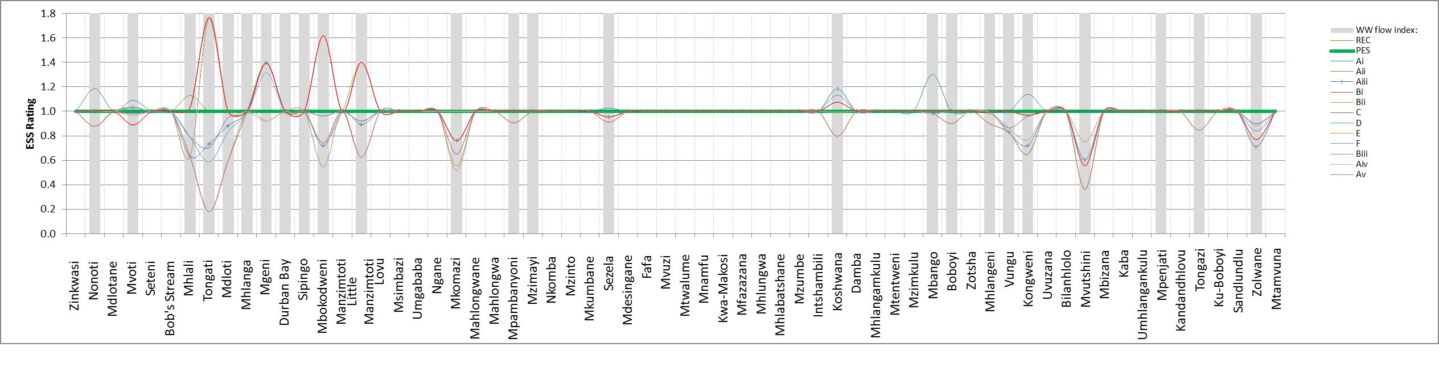
Summary of estuaries where senarios results in a change from the current state
IUA NC
IUA CC
IUA SC

Slide 5
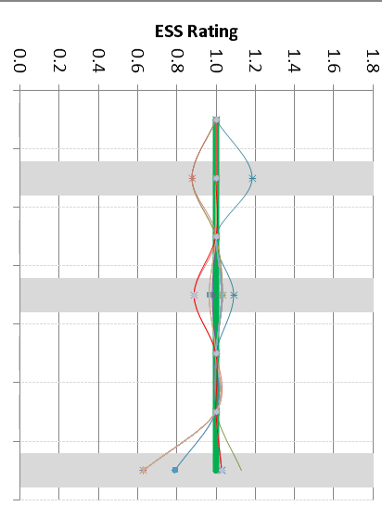
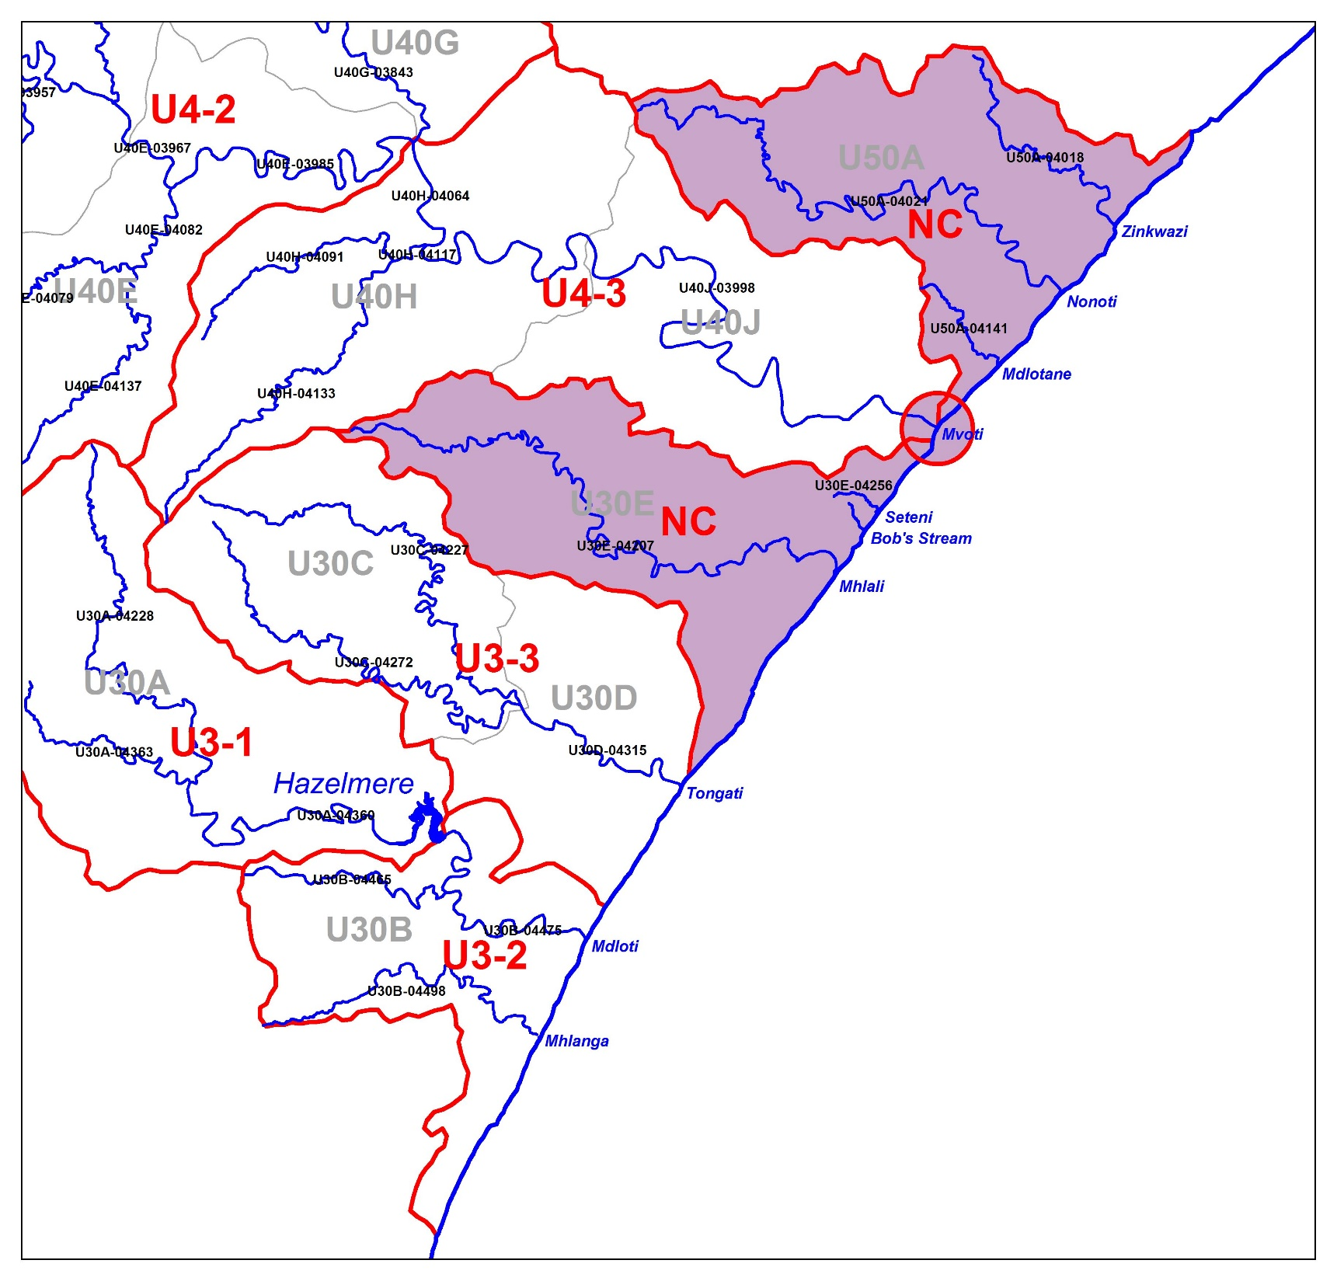
NORTHERN CLUSTER ESS CONSEQUENCES
Nonoti: Only scenarios with min discharge to estuaries show an improvement due to increased availability of fish. Scenarios that include discharge show a decline in fish. All other scenarios maintain status quo.
Mvoti: Similar trend to above
Mhlali: A group of scenarios that either maintain current state or have increased WW shows an improvement due to overall improvement in ecological functioning. Scenarios that impact negatively on water quality and mouth closure show negative ESS for invertebrate and fish presence.
Nonoti
Mvoti
Mhlali

Slide 6
NC ESTUARY WEIGHTS
Estuary | % Weight | Motivation
MHLALI | 28 | Aesthetic, recreational use
MVOTI | 27 | Average scores for all components
NONOTI | 45 | Aesthetic

Slide 7
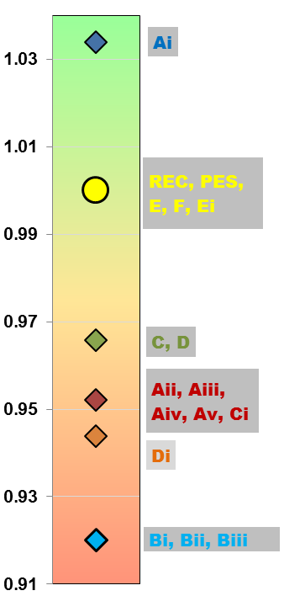
NORTHERN CLUSTER ESS CONSEQUENCES
All these scenarios maintain the current ESS state. One scenario marginally improves the state. These would be the recommended scenarios
All these scenarios decrease the ESS marginally.
The worst case scenarios are largely due to declining water quality and altered states that impact on fish and invertebrates.

Slide 8
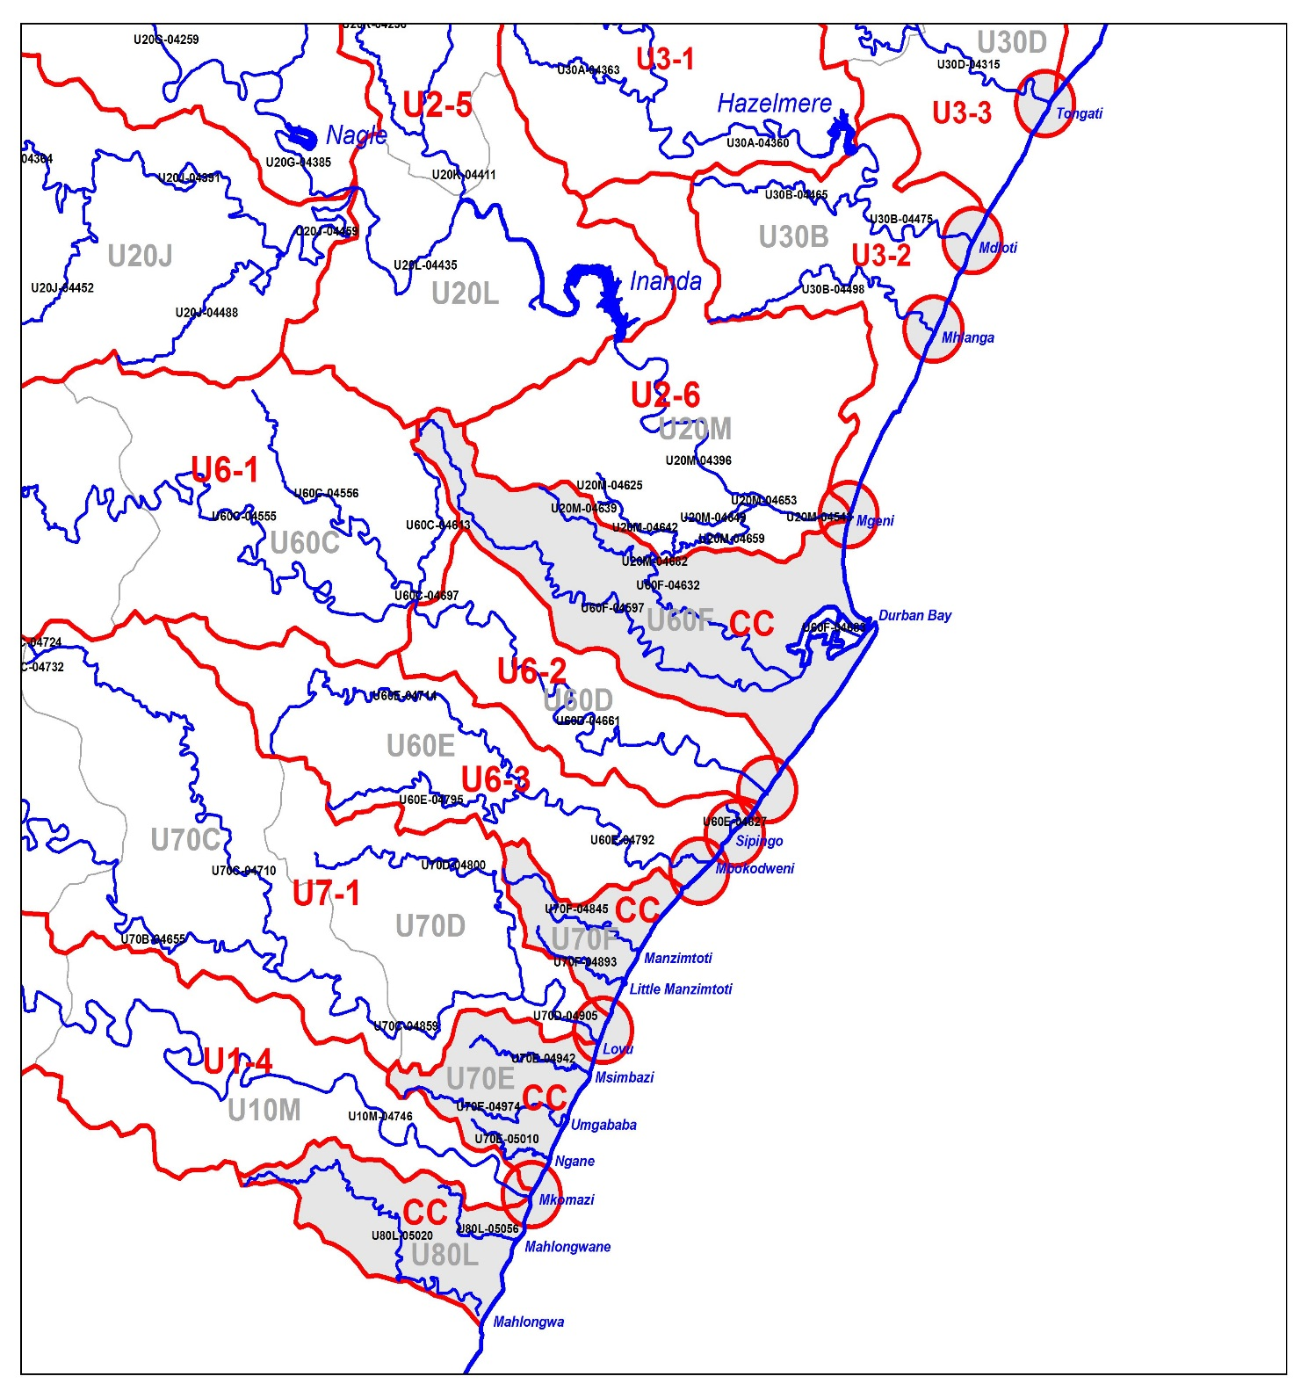
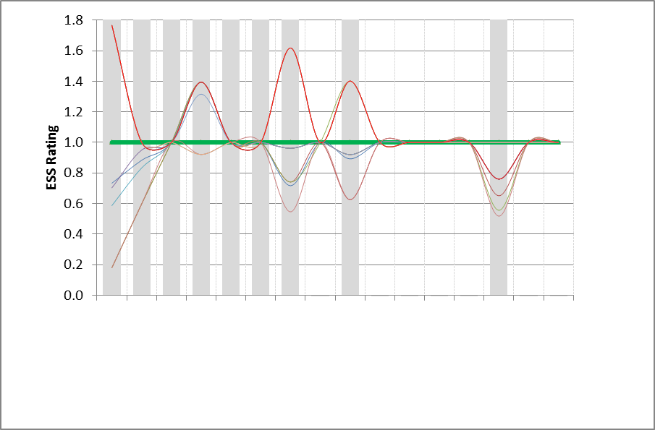
CENTRAL CLUSTER ESS CONSEQUENCES
Tongati Sc that removes the discharge: Significantly positive (fish, inverts, contact recreation), Ultimate WW Sc show reverse with very major -ve impact.
Mdloti Scs with increase in WW: –ve (fish, inverts, vegetation harvesting, contact rec
Mbokodweni similar to Tongati.
Little Amanzimtoti: Sc that removes the discharge significantly positive (fish, inverts, contact recreation). Sc that increase WW to ultimate capcity are –ve for reverse impact reasons.
uMkhomazi: Scenarios with WW development and transfer from Kingsburgh –ve with rec fishing, contact recreation, harvesting of inverts and vegetation all impacted.
Tongati
Mdloti
Mbokodweni
Little Amanz
uMkhomazi

Slide 9
CC ESTUARY WEIGHTS
Estuary | % Weight | Motivation
Little aManzimtoti | 17 | Aesthetic
uThongathi | 18 | Average score
Mbokodweni | 20 | Recreational use
uMdloti | 22 | Aesthetic
uMkhomazi | 23 | Aesthetic, recreational use, ritual, historic

Slide 10
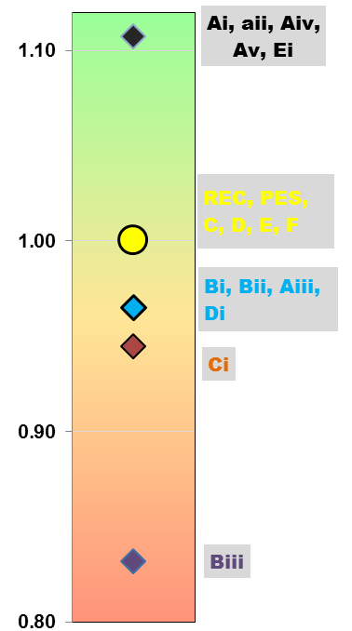
CENTRAL CLUSTER ESS CONSEQUENCES
All these scenarios maintain and improve the current ESS state. Taking into account that the Mkomazi is the most important, the range of A Sc and EI that improves it would be recommended.
All these scenarios decrease the ESS from the current state.
Sc Biii represent the worst case scenario due to impacts largely associated with recreational losses as well as livelihood losses in some instances.

Slide 11
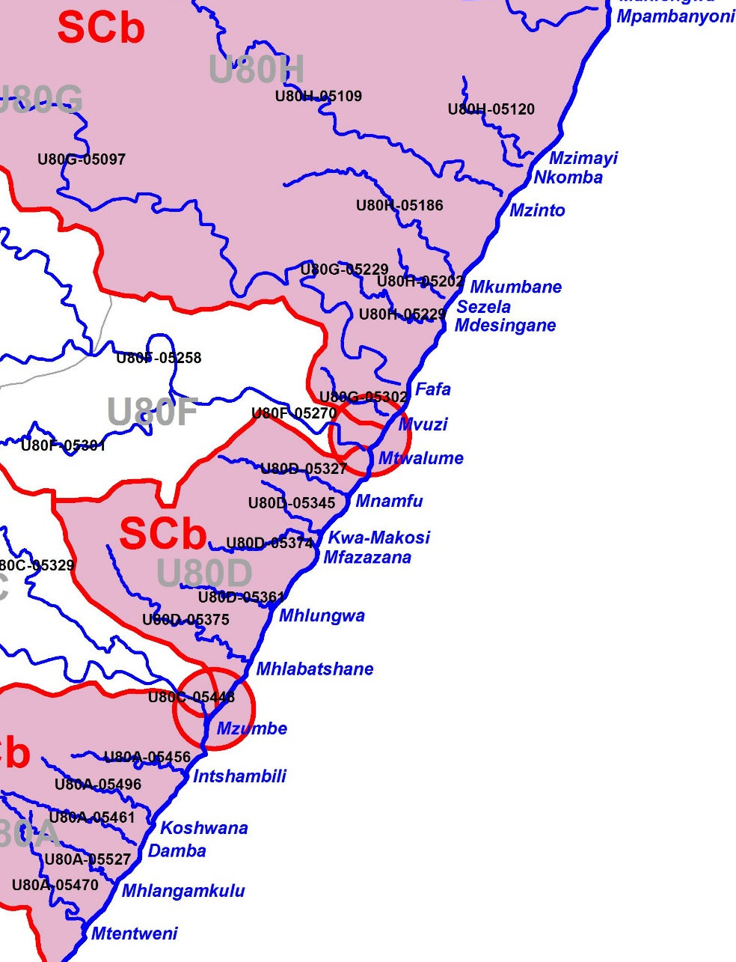
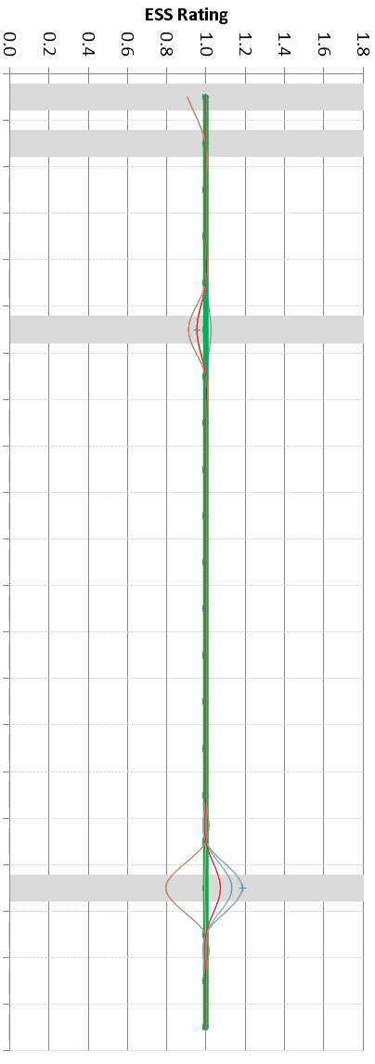
SOUTHERN CLUSTER B ESS CONSEQUENCES
Mpambanyoni
Most scenarios at Mpambanyoni neutral although some marginally – ve (rec fishing).
For the Sezela scenarios are mostly neutral, those proposing small increases in waste water discharge are marginally negative. (rec fishing, some contact rec). Scenarios at Sezela may be NB with impact at Pennington Blue Flag Beach.
Koshwana Estuary, most scenarios + ve. Largely related to potential improvements with respect to fishing under reduced waste water discharge Sc. Scs with elevated waste water discharges are negative for the reverse reasons.
Sezela
Koshwana

Slide 12
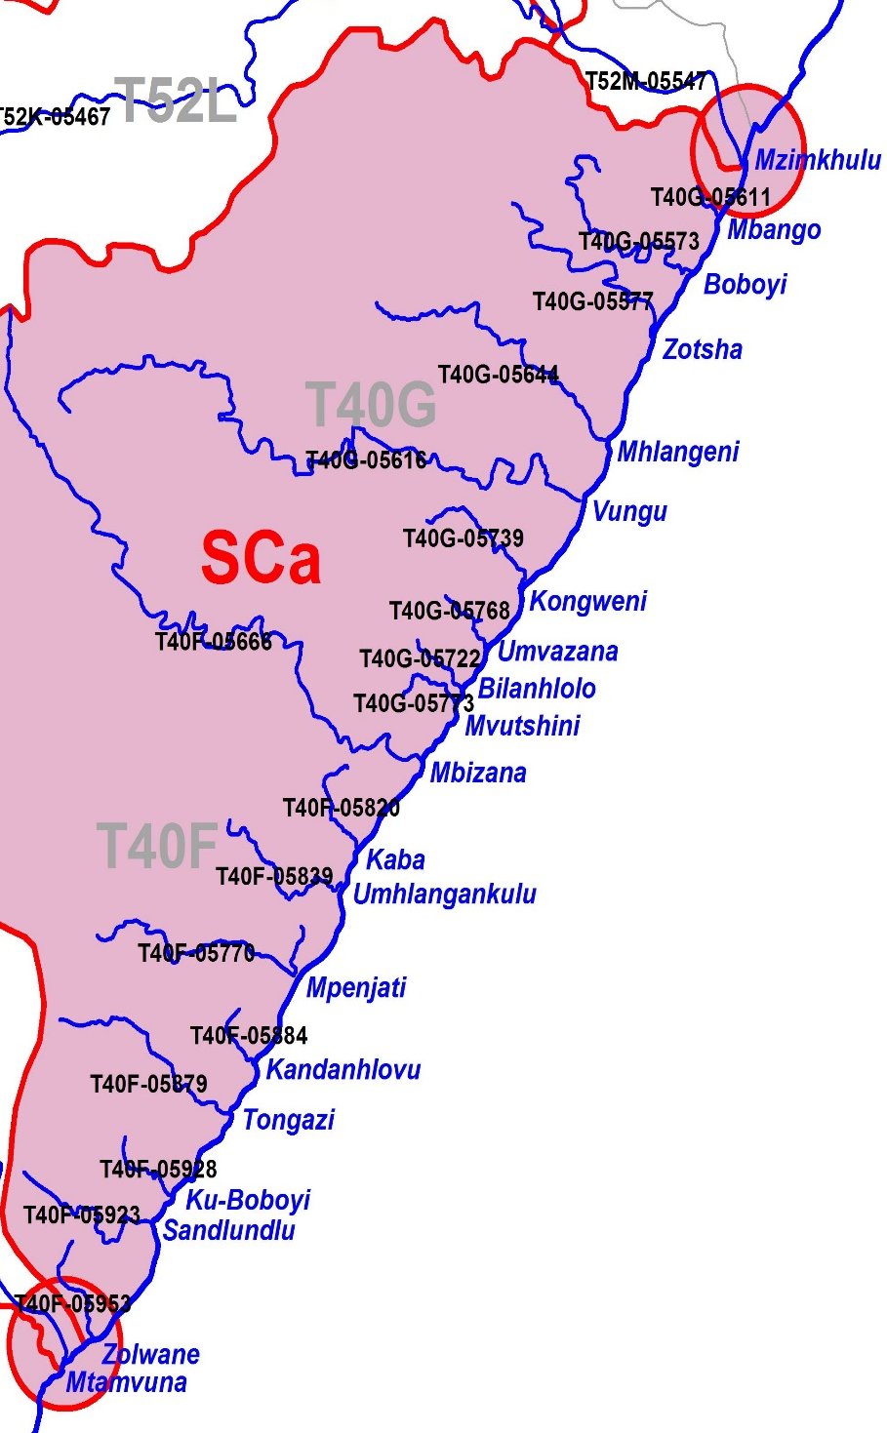
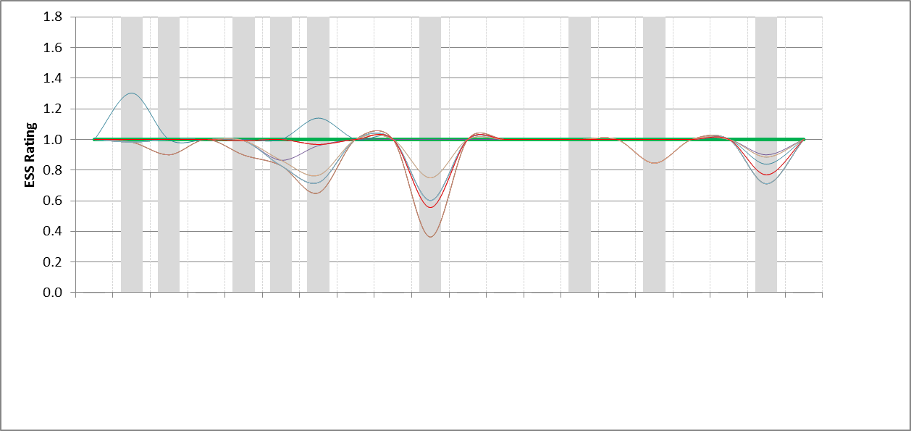
SOUTHERN CLUSTER A
Most scenarios at Mbango neutral. Exception of those prosing WW discharge decrease are +ve (subsistence fishing, contact rec).
Boboyi and Mhlangeni some scenarios marginal –ve.
Vungu with elevated levels of WW discharge all – ve. Driver is largely recreational fishing.
Kongweni – NB Blue flag beach (Margate) impact. Sc with reduced WW = +ve, Scs with elevated WW –ve (recreational fishing, inverts)
Mvuthsini (possible Ramsgate Blue Flag impact) Sc with introduction of WW discharge – ve (fishing, contact rec, inverts)
Tongazi Scs increasing WW – ve.
Zolwane Scs proposing introduction of WW discahrge -ve (fishing)
Mbango
Boboyi
Mhlangeni
Vungu
Kongweni
Mvutshini
Tongazi
Zolwane

Slide 13
SC ESTUARY WEIGHTS
Estuary | % Weight | Motivation
Mbango | 4 | Limited NB
Zolwane | 5 | Limited NB
Boboyi | 6 | Limited NB
Mvutshini | 9 | Limited NB
Koshwana | 9 | Limited NB
Sezela | 9 | Limited NB
Tongazi | 10 | Limited NB
Mhlangeni | 10 | Recreational
Vungu | 12 | Recreational
Mpambanyoni | 12 | Recreational
Kongweni | 15 | Aesthetic, recreational use

Slide 14
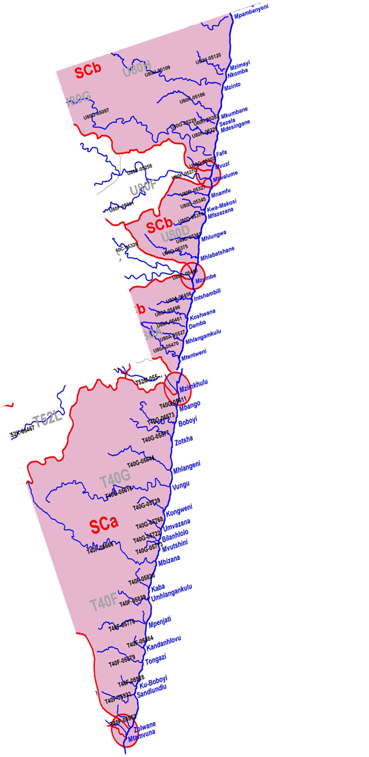
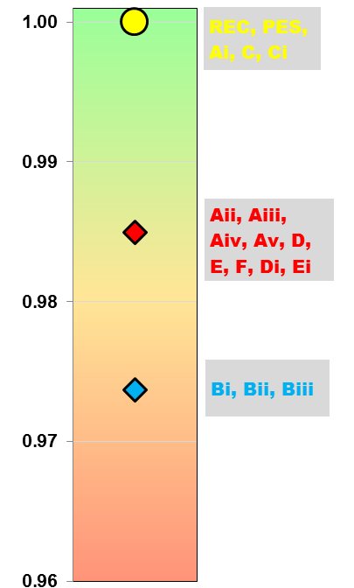
SOUTHERN CLUSTER ESS CONSEQUENCES
These scenarios maintain the current state.
These marginally decrease the ESS from the current state but impact is overall negligible.
Scs B are overall the worst case scenario due to multiple impacts mostly related to fishing losses (recreational and subsistence) as well as contact recreation impacts and loss of harvested invertebrates.

